Slide 1
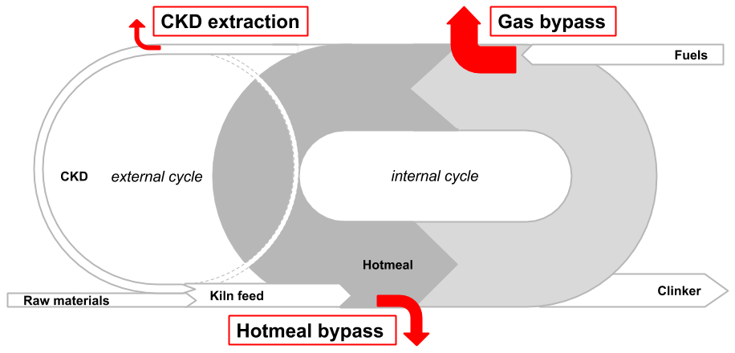
Chlorine bypass systems
SPREAD Course 2016, Settat, Sorin Petrescu - Geocycle

Slide 2
Table of contents
Chlorine challenges and basic solutions
Chlorine cycle in kiln system
Chlorine inputs by AFR
Kiln operating challenges with higher Cl inputs
Chlorine input limits
Cleaning
Chlorine bypass systems
CKD extraction
Hot meal bypass
Kiln gas bypass
Bypass dust treatment options

Slide 3
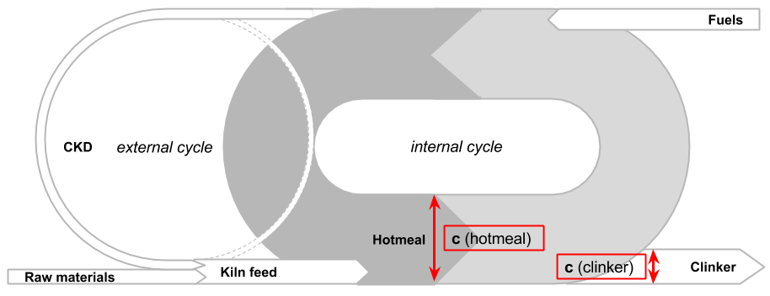
Cl is highly volatile and enriches in the kiln system (cycle)
Almost complete volatilization of Cl in the kiln due to the high temperatures. Internal cycle: Cl-volatility is 97-99% → 30-100x enrichment factor in the kiln.
The Cl volatility cannot be influenced by kiln operation.
External cycle: Fine dust enriched with chlorine - leaving preheater top stage - collected in main filter (raw mill) - returning to the kiln via kiln feed.

Slide 4
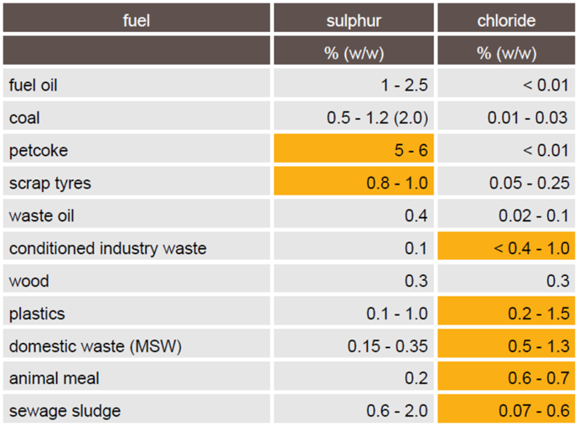
Chlorine input to the kiln system increases with AFR!
Most AFR have higher Cl concentrations than traditional fuels
Especially high contents can be found in:
AFR containing plastics (fluff, SRF, RDF)
MSW and AFR derived from it
Solvents (chlorinated)
Industrial wastes (sludges, FMCG, exp. pharmaceuticals,…)
Pesticides
Waste water
…
Source: ECRA
Notes:
FMCG – Fast Moving Consumer Goods - products that sell quickly at relatively low cost – items such as milk, gum, fruit and vegetables, toilet paper, soda, beer and over-the-counter drugs like aspirin.

Slide 5
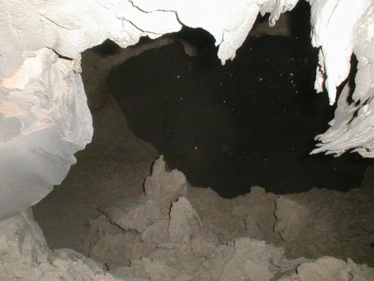
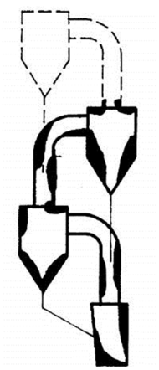
Operating challenges / effects of excessive Cl inputs
Build-up formation
Reduced cross-sections → increased pressure drop → reduced production rate (depending on gas handling capacity reserves, e.g. ID fan)
Cyclone blockages → kiln stops
Reduced kiln availability → production loss
Increased heat consumption
More cooling/heating-up → stress for refractories → reduction of refractory lifetime
Increased steel corrosion rates (kiln, riser duct, cyclones)
Deeper refractory infiltration
Potential increase of HCl emission (mainly for long wet/dry kilns, Lepol kilns)
→ reduced OEE without appropriate measures

Slide 6
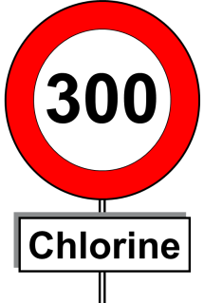
Sustainable/typical chlorine input limits for preheater kilns
Total chlorine input from fuels & raw materials*
200 - 300 g Cl/t cli without dust extraction
300 - 400 g Cl/t cli with kiln dust (CKD) extraction
1000 g Cl/t cli with 10% kiln gas bypass (~ 100 g Cl/t cli per 1% of bypass)
By using high amounts of bypass dust in cement in cement, we will face Cl limit given by cement standards: Typical chlorine limit cement: 0.1% Cl →Therefore, reasonable input limit: ~ 800 g Cl/ t clinker
* Example: If chlorine concentration in raw meal is 0.015% then the input by raw materials on clinker basis is already close to the limit! → 0.015% * 1.55 (= raw meal/clinker factor) = 0.023% = 230 g Cl/t clinker.

Slide 7
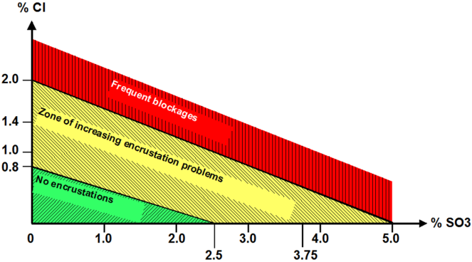
Understanding Cl balance as first step to alleviate chlorine issues
Know your chlorine input by raw materials
Sample and analyze AFR → know additional Cl input
Control the chlorine input by AFR
Blending, mixing
Adjust AFR feed rates according to chlorine content
Monitor your chlorine enrichment in the kiln
Analyze hot meal with adequate frequency “Adequate” means: more frequent the closer you are to the limit

Slide 8
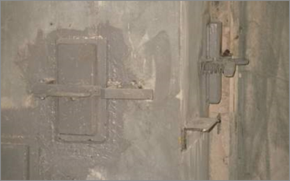
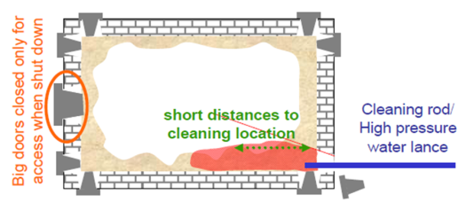
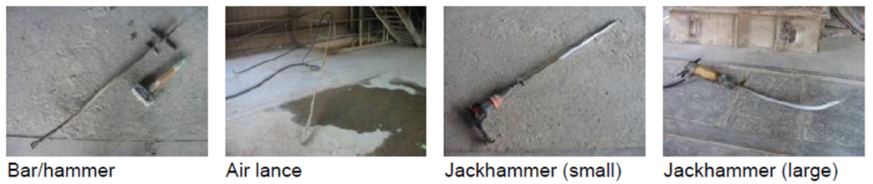
More build-up formation requires more & efficient cleaning
“Manual” cleaning
OH&S: Use personal protective equipment (Heat resistant jacket, pants, shoes and gloves, hood and face shield).
Need of well-designed cleaning ports at correct positions.
Different cleaning tools can be used depending on build-up strength.
High pressure water pump (WOMA) needs to be well-maintained and used only by trained personnel.

Slide 9
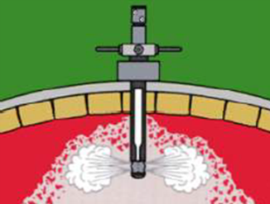
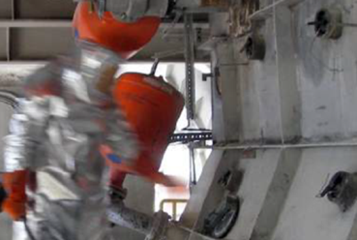
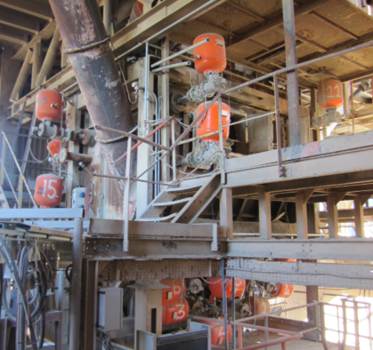
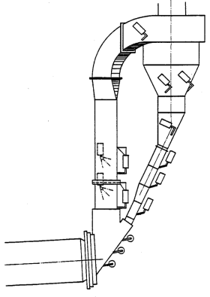
More build-up formation requires more & efficient cleaning
CARDOX: Powerful system for build-up removal by CO2 blasts.
“Automated” cleaning with air blasters

Slide 10
Other measures to reduce build-up formation and avoiding of kiln stops
Meal curtain / protection of riser duct
Correct design of splash boxes
Working meal pendulum flaps
Coating neutral refractory (SiC containing)
Avoiding false air
Modified (large) cyclone outlets to avoid cyclone blockages

Slide 11
Chlorine Bypass Systems

Slide 12
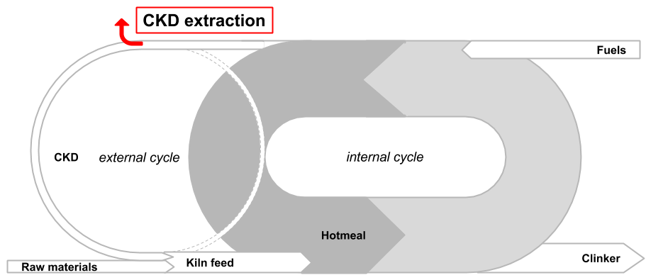
Extraction of kiln dust
Kiln dust (CKD) is enriched in chlorine and typically is fed back to the kiln. Typical concentrations: CKD: 0.1 - 0.4% Cl vs. Raw meal: 0.005 - 0.02% Cl.
Therefore it is effective to extract CKD, especially during direct operation
The absolute potential for Cl extraction depends on the concentration in the kiln dust and the raw mill operation time → typically ~ 50-120 g Cl/t cli
Usable CKD quantity in cement depends on type and Standards. Usually 5% are possible. Possible limitations: alkalis, LOI,..
Positive side effect: Kiln feed uniformity can be improved.
CAPEX: 0.8 to 1.5 Mio EUR, depending on country, silo size, plant layout (distances), civil cost, dosing to cement mill(s)…

Slide 13
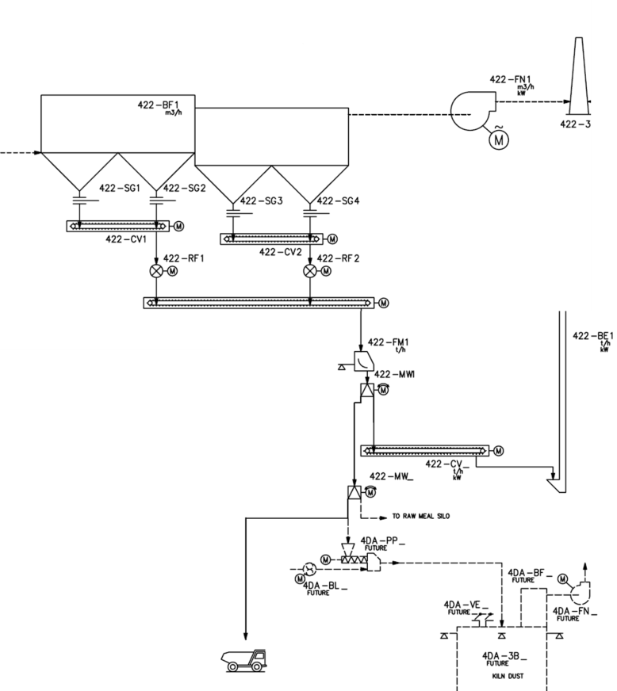
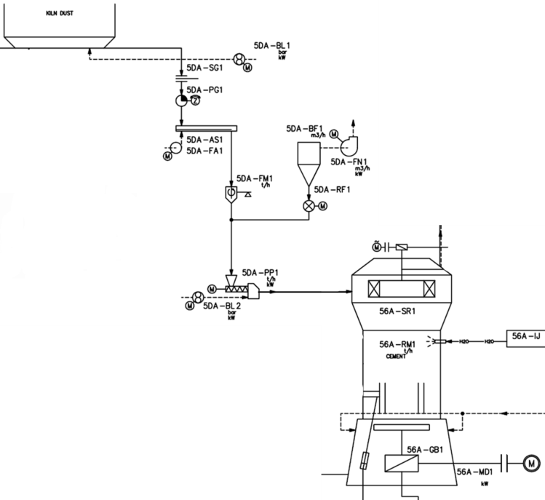
Flowsheet example for kiln dust extraction
Kiln dust extraction
Kiln dust dosing to cement mill
kiln dust silo
kiln feed
raw meal silo
kiln dust silo

Slide 14
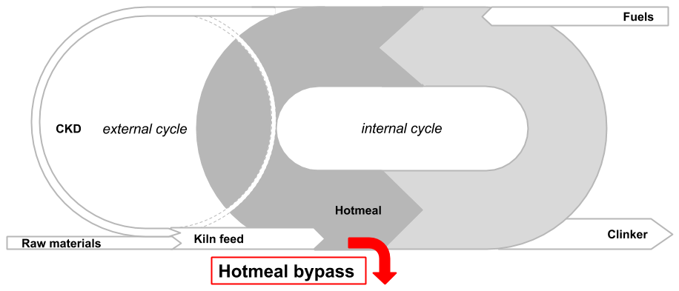
Hotmeal bypass
Few installations worldwide. Two references within LH, Altkirch (France) and Novi Popovac (Serbia → divested).
Hotmeal chlorine concentration: 1 to 3% Cl Extraction rate: ~ 1-2% referring to clinker production Extraction potential: 200 - 350 g Cl/t cli
Principle:
Extraction of hotmeal from lowest cyclone stage
Cooling of the hotmeal with fresh air
Dust (hotmeal) separation from air with cyclone
Final dedusting in dedicated filter or main filter
Advantages:
Low CAPEX and footprint: 0.6 – 1.2 Mio EUR installed (w/o dust silo, pneumatic dust transport and dosing to cement mill)
No increase of critical gaseous emissions (SO2, NOx, HCl, D/F, …)
Dust not sticky as Cl concentration is lower compared to BPD)
Disadvantages:
Hotmeal already (partially) de-carbonated. Monitor freelime in cement.
Impact on heat consumption, similar to kiln gas bypass.

Slide 15
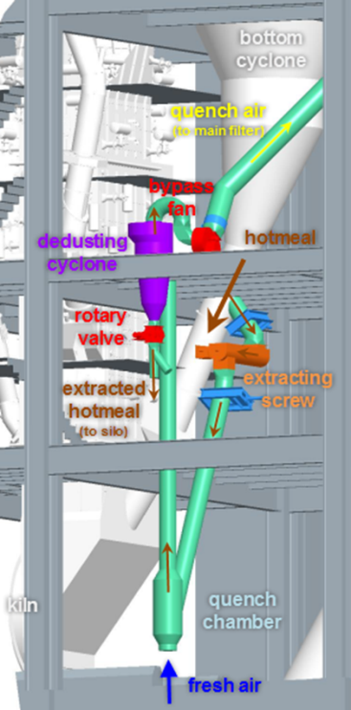
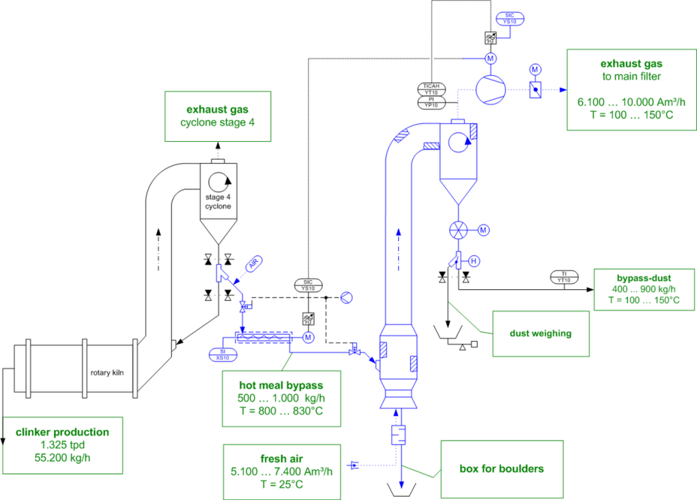
General arrangement / Flowsheet of hot meal bypass
Hot meal bypass from Altkirch plant

Slide 16
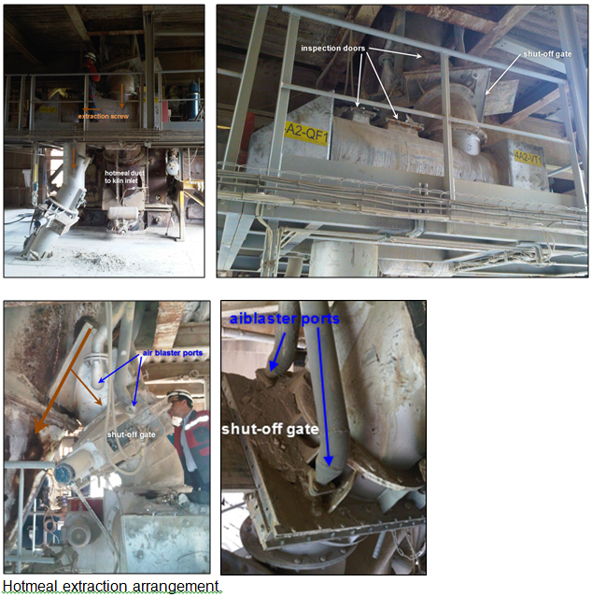
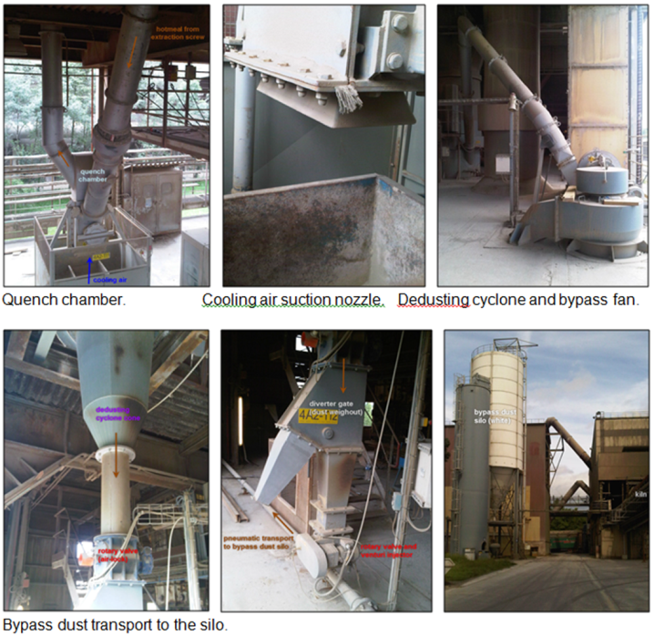
Pictures from hot meal bypass in Altkirch plant

Slide 17
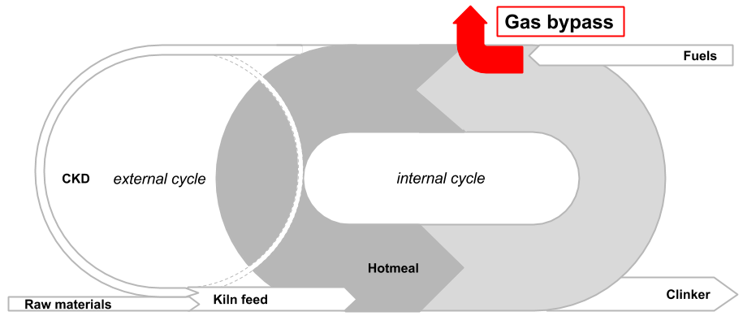
Kiln gas bypass
Principle: Extract volatiles (dust/gas) at highest enrichment and transform the gaseous volatiles into a salt (dust) and remove them from the system.
Due to the high Cl-volatility the kiln gas bypass is very effective.
~ 100 g Cl/t cli per 1% bypass, up to 1500 g/t clinker.
Advantages:
Additional AFR with more chlorine (TSR ↑ and TEE ↑)
Reduction of build-ups and cyclone blockages (→ OEE ↑)
Disadvantages:
Higher heat consumption (10-20 MJ/t clinker per % of bypass rate)
Increase of emissions (SO2, NOx, HCl, plume)
Additional and challenging bypass dust handling (sticky, depends on Cl conc.)
CAPEX and space: 4 - 6 Mio EUR (incl. dust transport, silo and dosing to CM)

Slide 18
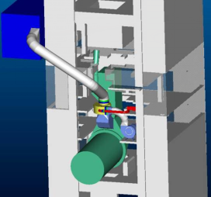
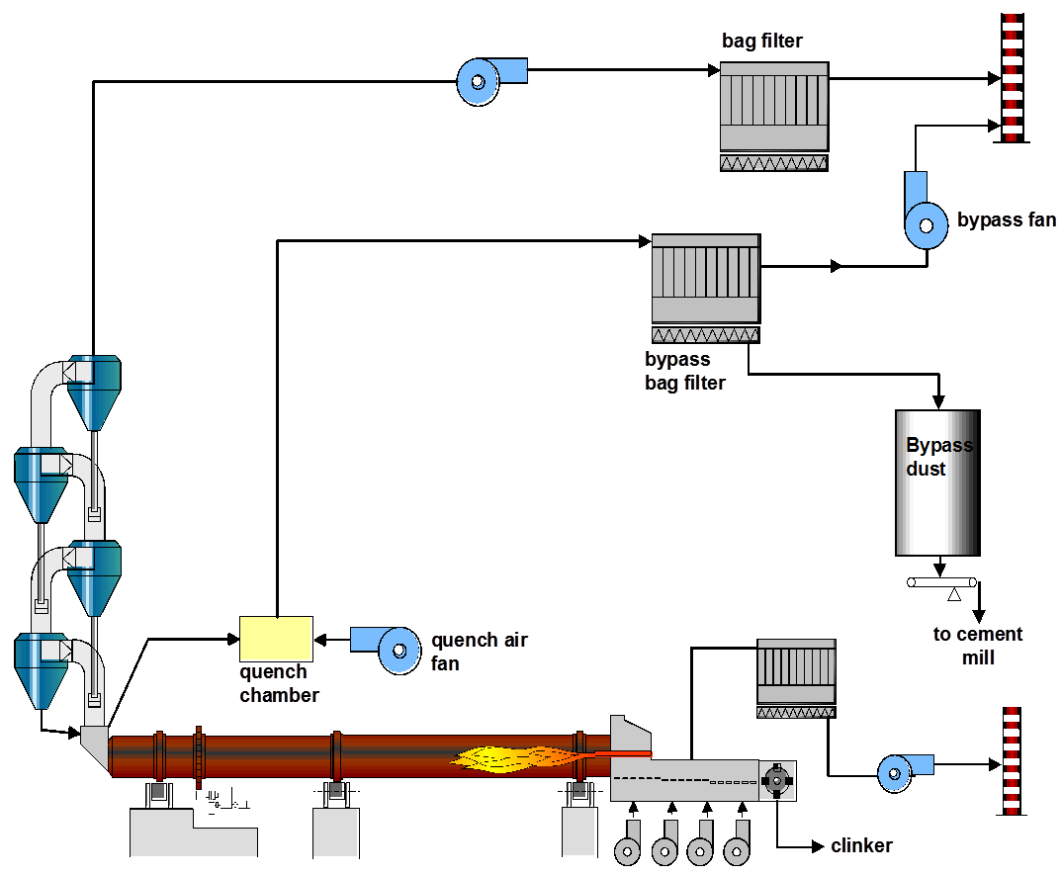
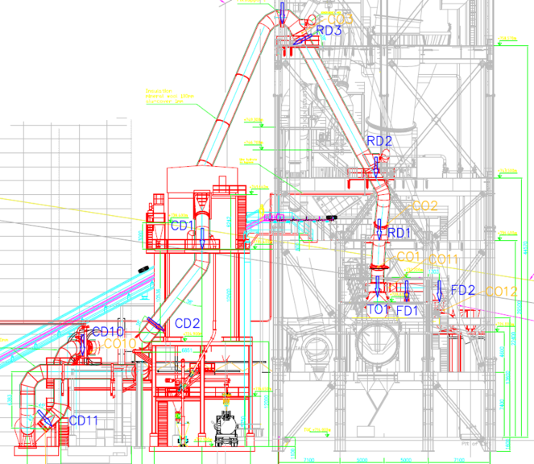
Gas chlorine bypass
18

Slide 19
Typical bypass operation control (PID)
some bypass system have 2-stage cooling: cond. tower / fresh air
T
Filter
T
Quench
Constant quench air
V
Flow
Quench air setpoint depending on hotmeal Cl concentration e.g. Cl ↑ → quench air fan (rpm) ↑

Slide 20
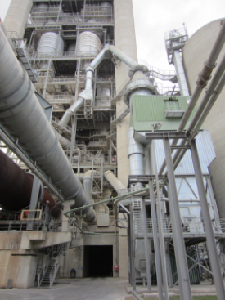
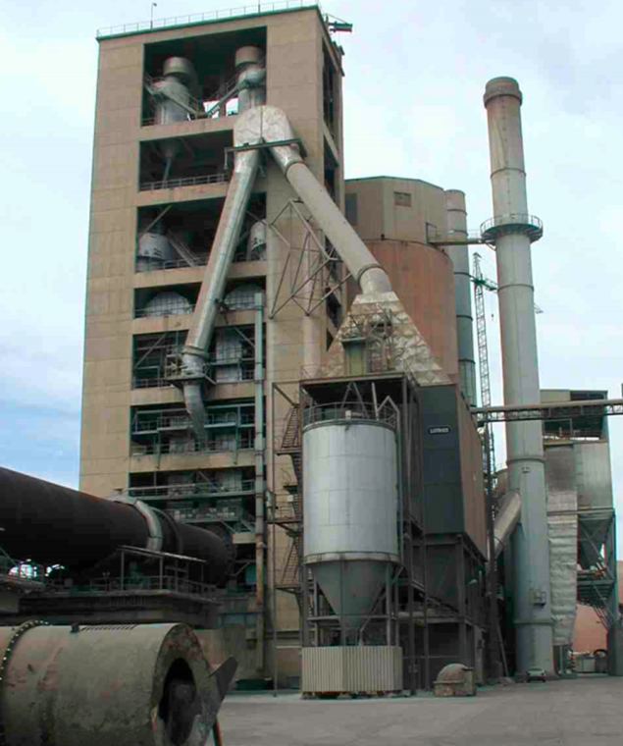
Illustration form bypass installations
Lägerdorf plant: with conditioning tower, bag filter
Carboneras plant: air quenching, hot EP

Slide 21
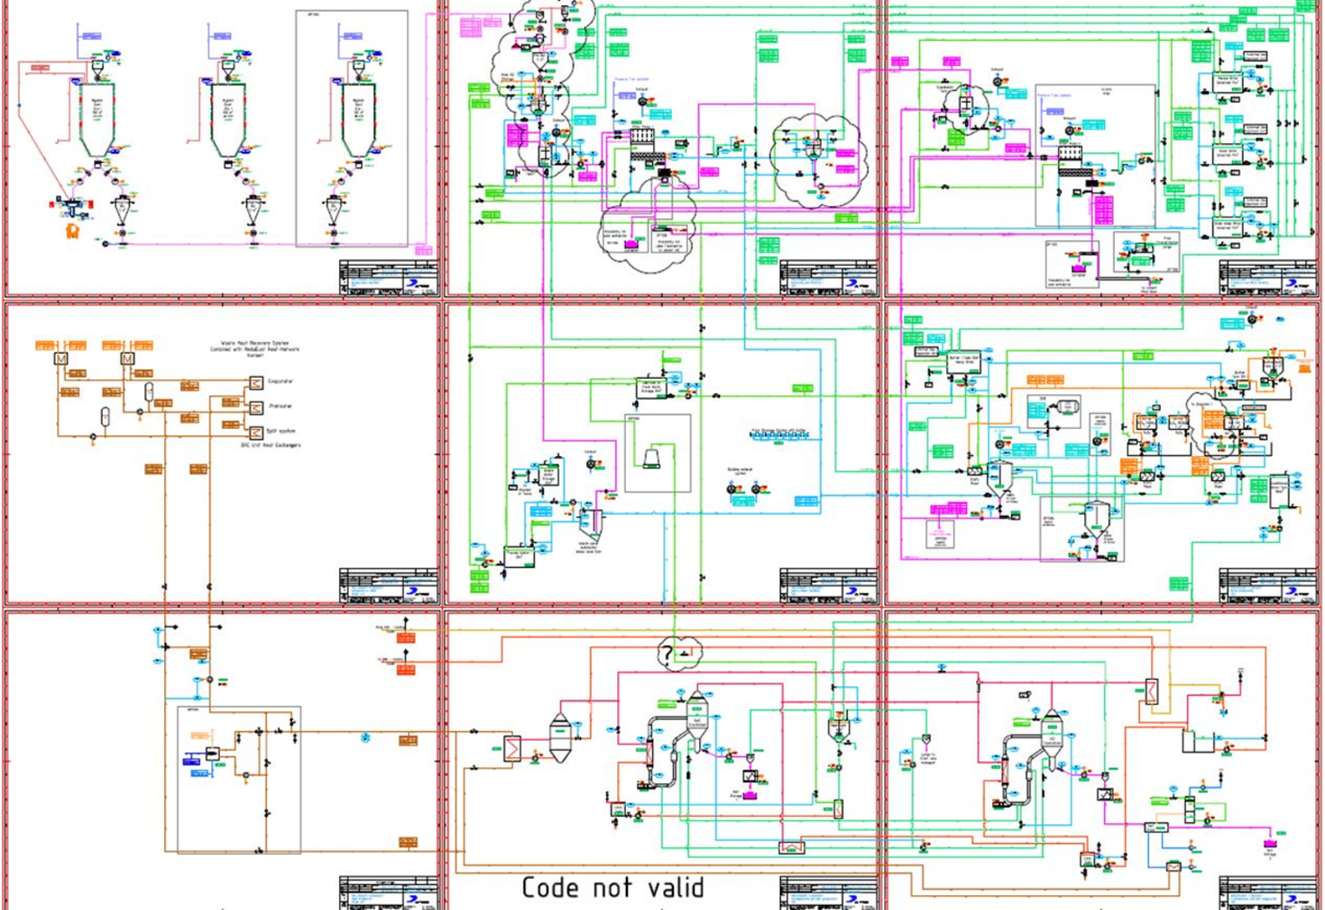
Bypass Dust Treatment Options

Slide 22
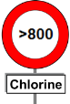
Bypass dust utilization: The “preferred solutions” are limited
Landfill
“No” Treatment
Bypass dust / CKD
Preferred solutions
Use in cement
Treatment
Innovation Project (ReduDust)
“saleable” product
Thermal
Leaching
-Special mortar -Road Binder -Solidification agent -Glass production (-Fertilizer)
- Fuller (>60 Mio$) - Polysius -Tribovent (N/A)
- Leaching -Chem. Treatment -Crystallizing
Products
Byproducts
Products
Byproducts
Byproduct
-Clinker -MIC -low grade MIC
-Alkali-S-Cl- Concentrate -Usable as ? -HM
-Raw Mat -MIC -Saleable salts (fertilizer, deicing)
- Leachate - Brine (to sea or river) - HM

Slide 23
ReduDust process principle
Mixing
Filtration
Chemical
treatment
Crystallization
1. Process
Filtering
brine
brine
Pre-treatment
CO2
Evaporation
water
bypass dust
HM precipitation
Na2S
Rapid mixing
treated brine
Oxidation
H2O2
filter cake
Neutralization
HCl
Cooling crystallization
Filtering
2. Products
filter cake
limestone
HM sludge
KCl salt
fractions
Cement grinding
ReduDust plant
ReduDust plant
Salt applications

Slide 24
Target Chlorine generation balance with ReduDust: A very simple balance with a plant capacity of 1.1 mio t cli/a in Rohoznik
Target
(TSR 80% full capacity)
Fuel Input:
Petcoke = 2
SRF MB = 402
SRF HD = 1460
Cement
additives
Input = 127
bypass
Dust = 104
Raw material :
40
in tons chlorine per year
104
Raw material
preparation
Clinker production
Cement
grinding
Cement
Production
(clinker and cement)
40
434
767
bypass Dust
1471
Road Binder
production
350
ReduDust Chlorine Utilization
ReduDust
1017
Salt production
Pure KCl
915
640
Filter cake
102
Mixed salt
274

Slide 25
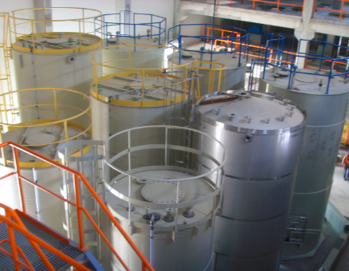
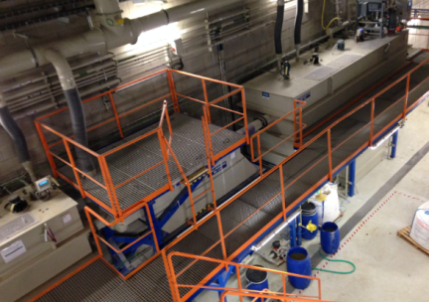
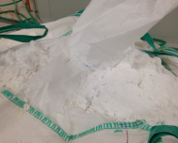
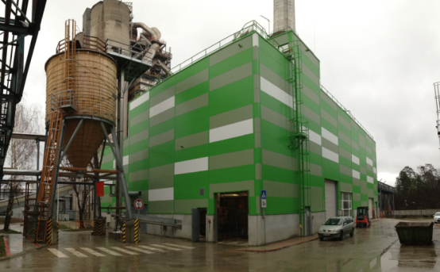
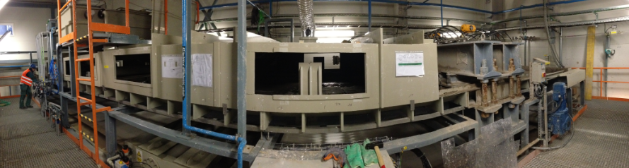
Key figures of the ReduDust project
Joint development A TEC/Holcim Slovakia/HTEC (Patent filed)
Capacity: 20’000 t/a bypass dust (5 t/h)
Waste heat (WHR) used for crystallizer operation
Capex ~ 10 Mio EUR
Estimated treatment cost: 20-30 EUR/t BPD
Estimated selling price KCl: 150-200 EUR/t
Comissioning: Q2/3 2014

Slide 26
Summary / Key messages
Chlorine input increases with AFR.
Know your inputs from AFR and respect the kiln input limits.
Monitor volatile elements in kiln system and build-up situation. Efficient and frequent cleaning is required!
Waste/AF disposal fee should also reflect material’s Cl content.
The classic gas chlorine bypass is very effective but expensive, however will allow boosting the AFR utilization.
CKD extraction and hot meal bypass are cheaper solutions for chlorine removal → possible intermediate step in “AFR Journey”.
Technology for bypass dust treatment (leaching) is studied and operating (yet with issues) in Rohoznik plant. Business case only at plants with high dust landfill costs and attractive AF prices.

